Slide 1
Chemistry – Dec 3, 2019
P3 Challenge-
Name an alkali metal.
Name a transition metal.
Name a halogen.
Objective –
Periodic Properties
Atomic Structure
Pick up 4 handouts

Slide 2
Chemistry – Nov 28, 2018
Objective –
Periodic table: Properties
Atomic Structure / Bohr Model
Atomic Structure / Quantum Mechanics
Assignment: Bohr Model Worksheet, Atomic Structure Worksheet
Agenda
Periodic properties
Metals/nonmetals
More about elements
Atomic Structure overview
Bohr Model
Orbital Shapes
Atomic Structure
Quantum Numbers

Slide 3
Elements within a Group share Chemistry – Periodic Law
Alkali metals (Group 1) are soft enough to cut with a butter knife, react with water, form strong bases
Alkaline earth metals (Group 2) are similar to alkali but less reactive with water and harder. They also form strong bases.
The halogens (Group 17) form diatomic molecules and vary in states down the group from gases to solids. They are nonmetals and react with metals to form salts. They react with water to form acids.
The noble gases (Group 18) are unreactive and exist as gases.

Slide 4
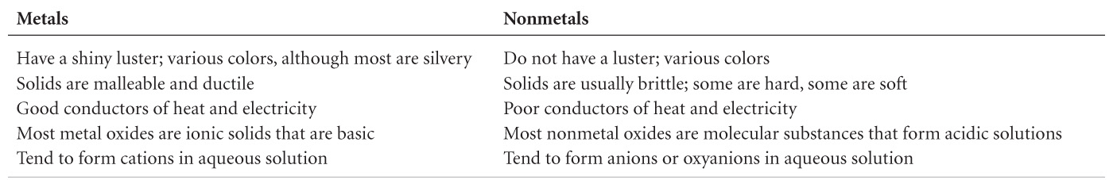
Metals / Nonmetals / Metalloids
Differences between metals and nonmetals tend to revolve around these properties.
Metalloids have some properties from both lists.

Slide 5
States of the elements
Everything on this slide is a memory item.
Most elements are solids.
There are two liquids: Br₂ and Hg
There are 11 gases: H₂, N₂, O₂, F₂, Cl₂ , He, Ne, Ar, Kr, Xe, Rn
There are 9 molecular elements H₂, N₂, O₂, F₂, Cl₂ , Br₂, I₂, S₈, P₄
All others exist as individual atoms.

Slide 6
Distribution of elements in nature
98 naturally occurring elements (1 – 98)
93 – 98 only in small amount added recently, so most people say 92
60 elements used in the human body
6 most common make up 99%: O (65%), C(18%), H(10%), N, Ca, P
5 significant ones make up 0.85%: K, S, Na, Cl, Mg
Trace others: Fe, F, Zn, Si, Rb, Sr, Br, Pb, Cu Al, Cd, Ce, Ba, Sn, I, Ti, B, Se, Ni, Cr, Mn, As, Li, Hg, Cs, Mb, Ge, Co, Sb, Ag, Nb, Zr, La, Te, Ga, Y, Bi, Tl, In, Au, Sc, Ta, V, Th, U, Sm, W, Be, Ra
Most abundant in universe: H (74%), He (24%)
Most abundant for earth: Fe (32%), O(30%), Si(15%), Mg(14%), S, Ni, Ca, Al
Most abundant for earth’s crust: O(47%), Si(28%), Al(8%), Fe(5%), Ca, Na, K, Mg

Slide 7
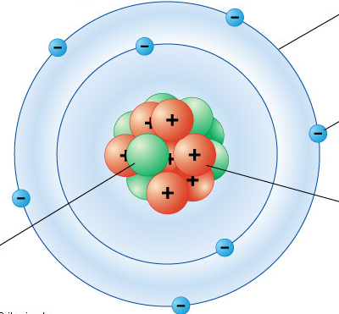
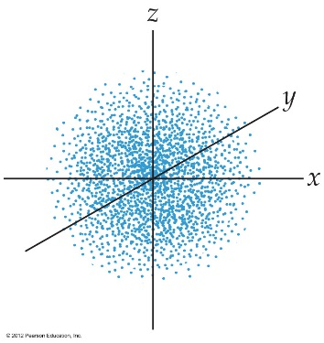
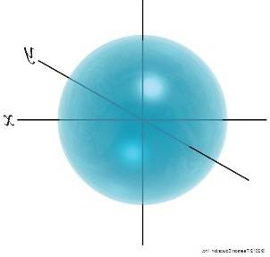
Review Atomic models
Recall the Nuclear model and where subatomic particles are located
Recall the Bohr model that uses quantized orbits
Recall Quantum Mechanics that uses quantized orbitals
Orbitals that we draw represent a 95% probability of finding an electron in that space.
Any single orbital can contain up to two electrons (0, 1, or 2)

Slide 8
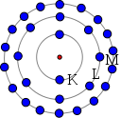
Bohr Model
Based on x ray spectra line data
Electrons located in nested shells located in specific quantized orbits
Shells given labels from Xray spectra: K, L, M, N.
Each shell can hold only a given number of electrons:
K – 2 electrons
L – 8 electrons
M – 18 electrons
N – 32 electrons
The build an atom app used an unlabeled Bohr model.

Slide 9
Example
Draw the Bohr model for the most abundant isotope of Phosphorus.
Z = From Periodic Table
Gives #p and #e for neutral atom.
Find most abundant isotope mass number, A = on list of abundances.
Determine #n. A – Z
Draw a nucleus for the neutrons and protons. Label.
Draw a circle around the nucleus for K. Place up to 2 electrons on this orbit.
Draw a circle around K for L. Place up to 8 electrons on this orbit.
Continue with M and/or N with 18, and 32 electrons, until all electrons used.

Slide 10
Exit Slip - Homework
Exit Slip: Draw the Bohr Model for Oxygen-16
What’s Due? (Pending assignments to complete.)
Bohr Model Worksheet
What’s Next? (How to prepare for the next day)
Read Holt p84 - 88

